Slide 1
Ontology, Epistomology Methodology Paradigms in research
Dr Rica Viljoen

Slide 2

Research paradigms and Logic of Research
Plato
c. 348–347 BC
Logic/ Ethics
“Objects are inherently good, just”
“Things are beautiful, unified, equal”

Slide 3
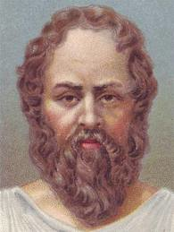
Research paradigms and Logic of Research
Socrates
c. 469 / 470 BC
Contribution to Epistemology, Ethics, Logic:
“I know that I know nothing”
“Knowledge is always proportionate to the realm from which it is gained.”

Slide 4
Research paradigms and logic of research
Implications for Qualitative research
Dr Rica VIljoen

Slide 5
What is a paradigm?
"universally recognised scientific achievements that, for a time, provide model problems and solutions for a community of researchers", i.e.,
what is to be observed and scrutinised
the kind of questions that are supposed to be asked and probed for answers in relation to this subject
how these questions are to be structured
how the results of scientific investigations should be interpreted
how is an experiment to be conducted, and what equipment is available to conduct the experiment.
Kuhn, T S (1970) The Structure of Scientific Revolutions (2nd Edition) University of Chicago Press. Section V, pages 43-51

Slide 6
What is a paradigm?
The word paradigm is used to:
Indicate a pattern or model or an outstandingly clear or typical example or archetype
Also:
cultural themes
worldviews
Ideologies
mindsets.
It describes distinct concepts or thought patterns in any scientific discipline or other epistemological context.

Slide 7
Paradigm
ORIGIN late 15th cent.: via late Latin from Greek paradeigma, from paradeiknunai ‘show side by side,’ from para- ‘beside’ + deiknunai ‘to show.’

Slide 8
Main components of a Paradigm
Ontology
Concerned with Being
How do you look at reality?
Epistemology
Branch of philosophy concerned with the origins, nature, methods and limits of knowledge?
Methodology

Slide 9
What is research?
“A studious inquiry or examination , especially a critical investigation or experimentation having for its aim the discovery of new facts and their correct interpretation, the revision of accepted conclusions, theories, or laws in the light of new discovered facts or the practical application of such conclusions, theories or laws.”

Slide 10
Guba and Lincoln (1994)
Ontology:
Assumptions about the nature of reality
Epistemology:
How the researcher comes to know that reality
Methodology
How the researcher access and report what is learned about the reality

Slide 11
Summary
Ontological assumption: There is a reality that can be apprehended. We can determine “the way things are” and, often, discover the cause effect relations behind social reality. At the least, we can find meaningful indicators of what is “really” happening.
Epistemological assumption: The investigator and the object of investigation are independent from each other and the object can be researched without being influenced by the researcher. Any possible researcher influence can be anticipated, detected, and accounted for (controlled).
Axiological assumption: Values are excluded from the research process. They are considered confounding variables-phenomena that cloud our view of reality.
Methodological assumption: The most prevalent methods used include experiments, quasi-experiments, and other hypothesis-testing techniques. Meaningful phenomena are operationalized by determining variables that can be accurately measured.
Rhetorical assumption: The research is written from the perspective of the disinterested scientist. Typically, our report is couched in mathematical terms.

Slide 12
Chalmers (2002)
Ontology is the study of beings or their being – what is;
Epistemology is the study of knowledge – how we know;
Logic is the study of valid reasoning – how we reason;
Ethics is the study of right and wrong – how we should act; and
Phenomenology is the study of our experience – how we experience

Slide 13
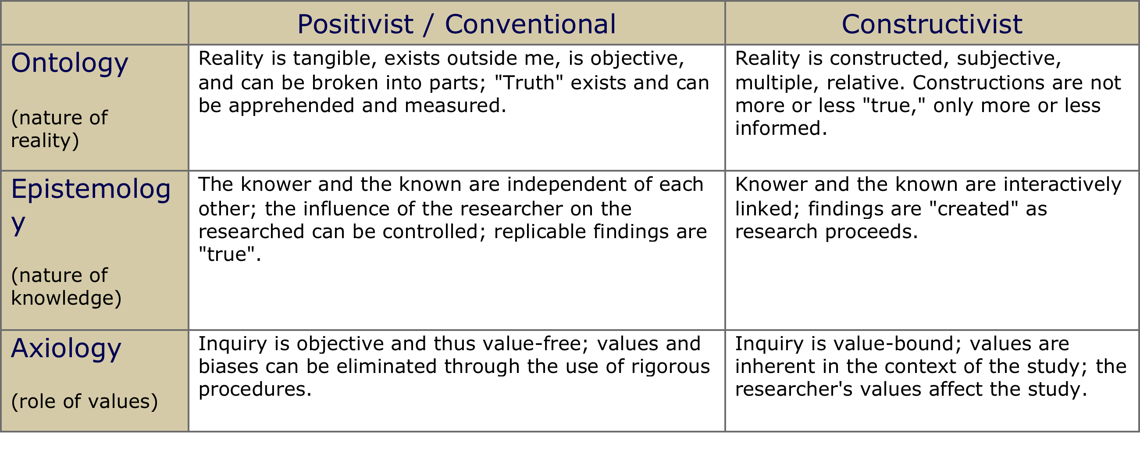
Example

Slide 14
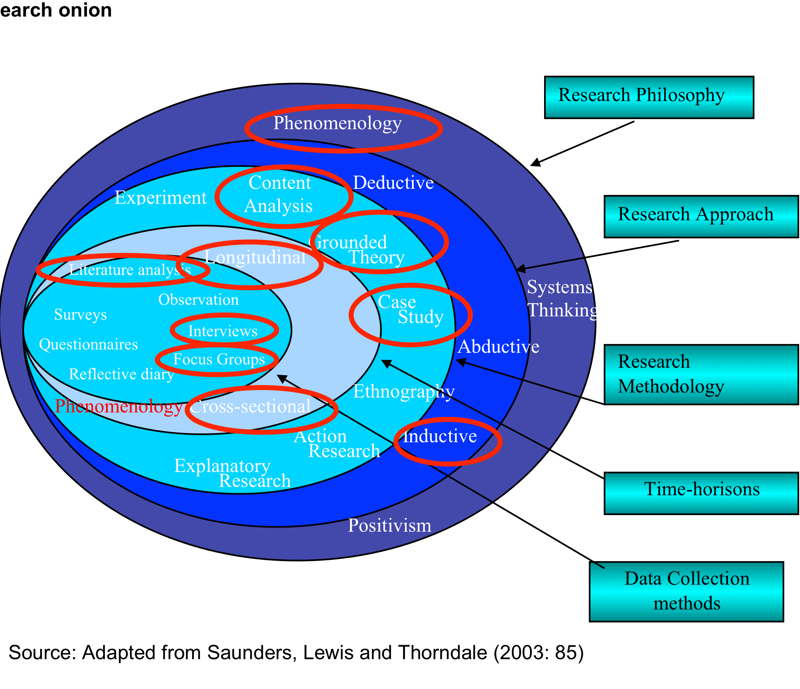
Research Onion

Slide 15
Ontology
ORIGIN early 18th cent.: from modern Latin ontologia, from Greek ōn, ont- ‘being’ + -logy.
Ontology is the starting point of all research, after which one’s epistemological and methodological positions logically follow. A dictionary definition of the term may describe it as the image of social reality upon which a theory is based.

Slide 16
Ontology
Denzin and Lincoln (1994) point out that it is crucial to consider the researcher’s personal sentiments, beliefs and relationship to the subject matter, as this may have a bearing on the method chosen, i.e. the researcher’s Ontological persuasion

Slide 17
Ontology
According to Bryman (2008:18) the ontological issues are having to do with whether the social entities can and should be considered objective entities that have a reality external to social actors, or whether they can and should be considered social constructions built up from the perception and actions of social actors. These opposite points of view are referred to as Objectivism and Constructivism respectively.

Slide 18
Objectivism
This ontological position implies that social phenomenon is regarded as a ‘fait accompli’, and that those external facts are beyond our reach and therefore influence. A typical example is that of an organisation. The organisation can be regarded as a “persona” having rule and regulation, there is a system, there is a hierarchy, and from the outside looking in, the member needs to adapt and align to the workings of the organisation if he/she wants to survive. In this instant, the organisation exhibits a constraining force that acts upon and inhibits its members

Slide 19
Objectivism
Objectivism presupposes that social reality has an autonomous existence outside the knower (researcher).
Eriksson & Kovalainen (2008)
Bryman & Bell (2007).

Slide 20
Constructivism
Constructionism (also known as subjectivism) is an ontological position asserting that social phenomenon and their meaning are continually being accomplished by social actors, and that they are in constant construction and revision. (Bryman, 2008:19).
Taking an organisation and culture again as examples, constructivism infers the continuous change, updating and rejuvenating of the existing social structures. (Becker 1982:521 as quoted by Bryman 2008:20).
People, individuals and/or groups are definitely able to influence existing structures that at first seem external and alien. After all, the organisation and culture itself should be viewed rather as a collective extension of the individuals wants, needs and meaning, cohorted into an assemblage that eventually is known as an enterprise or a particular culture.

Slide 21
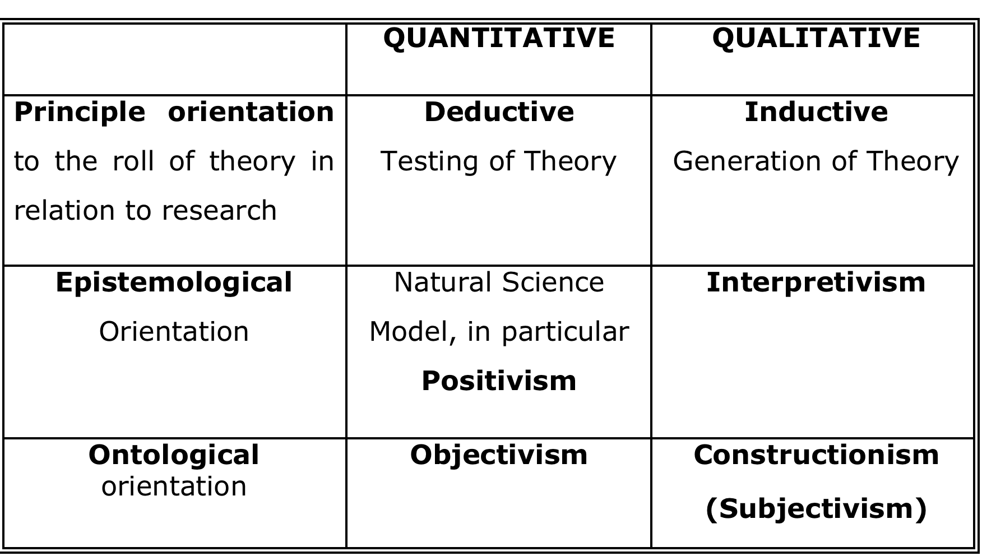
Bryman (2008:22)

Slide 22
Epistemology
ORIGIN mid 19th cent.: from Greek epistēmē ‘knowledge,’ from epistasthai ‘know, know how to do.’
Epistemology is the branch of Philosophy that studies knowledge, by attempting to distinguish between ‘True’ (and adequate) knowledge and ‘False’ (inadequate) knowledge. (Erikson and Kovalainen, (2008:14).

Slide 23
Realism
Emergencesince the 1960’s of a second philosophical position within the epistemological discourse, that of realism, and in particular, Critical Realism. Critical Realism takes the view that change can only take place if the structures responsible for the events and discourses are known and influenced. As Bhaskar (1989:2) points out:
These structures are not spontaneously apparent in the observable patterns of events. They can only be identified through the practical and theoretical work of the social sciences.

Slide 24
Interpretevism
Interpretivism, (also known as Post-positivism), is a term given to a contrasting epistemology to that of Positivism. (Bryman 2008:16). It concerns the theory and method of the interpretation of Human Action. While positivist’s point of departure is to explain human behaviour, the social sciences are more concerned about understanding human behaviour.
As Max Weber (1864-1920) pointed out, time has come for us to “Understand” social dynamics, (Translated from the German word of ‘Verstehen’, meaning “to understand”) and not simply to “measure” it.

Slide 25
Interpretevism
Interpretevism as a philosophical position within an epistemological stance that treats reality as being fluid, knowledge is subjective, everyone has a ‘common sense thinking’ and the truth lies within the interpretation of the persons reality, upon which he/she accordingly acts, reacts and interacts with that ‘reality’.
This phenomenon is subject to the person’s beliefs, values, culture, standing, language, shared meaning and consciousness. (Bryman, 2008:17; Grbich, 2010; Meyers,

Slide 26
Interpretevism
Interpretevism or interpretive theory as per Charmaz, (2006:126), calls for the imaginative understanding of the studied phenomenon. This type of theory assumes emergent, multiple realities; indeterminacy; facts and values as linked; truth as provisional and social life as processual.

Slide 27
Existentialism
The following assumptions emerge:
Existence is always particular and individual
It is the problem of the mode of being and therefore also an investigation of the meaning of being
The investigation is continually faced with diverse possibilities, among which the individual must make a selection and commit himself to
Because these possibilities are determined by the individual’s relationships with other human beings and things, existence is always a situation that limits or conditions choice
Versfeld (1992), Existentialism, 2011

Slide 28
Constructivism
Constructionism or a constructivist grounded theory approach places priority on the phenomenon of study and sees both data and analysis as created from shared experiences and relationships with participants. (Charmaz, 2006:130).

Slide 29
Positivism
One of the central questions in epistemology is the question of whether the social world can, and in fact should be, studied according to the same principles, procedures and ethos as the natural sciences. (Bryman 2008; Meyers, 2010; Eriksson & Kovalainen, 2008; Bryman & Bell, 2007). When assuming an epistemological position based on the natural sciences, i.e. the composition of reality from observable material objects, it is known as Positivism.

Slide 30
Positivism
Positivism adopts a quantitative approach to investigating phenomena, assuming an Epistemological position that advocates the application of the methods of the natural sciences to the study of social reality, as opposed to post-positivist approaches, which aim to describe and explore in-depth phenomena from a qualitative perspective, according to Proctor (1998) and Bryman (2008).

Slide 31
Phenomenology
Despite the fact that phenomenology has a theoretical orientation, it does not generate deductions from propositions that may be empirically tested (Darroch & Silvers 1982).
Phenomenology operates more on a meta-level, and demonstrates its premises through descriptive analyses of the procedures of the self, and the situational and the social setting. Phenomenology is the study of the contents of consciousness – phenomenon – and phenomenological methods are ways in which these contents may be described and analysed (Sokolowski, 2000).

Slide 32
Philosophical underpinning
At the heart of all research, is an endeavour to find out, to investigate, confirm, probe, test, see or view, measure, correlate, compare, evaluate, find meaning, gain understanding, or to discover new emerging properties.
Bless, Higson & Kagee (2006)

Slide 33
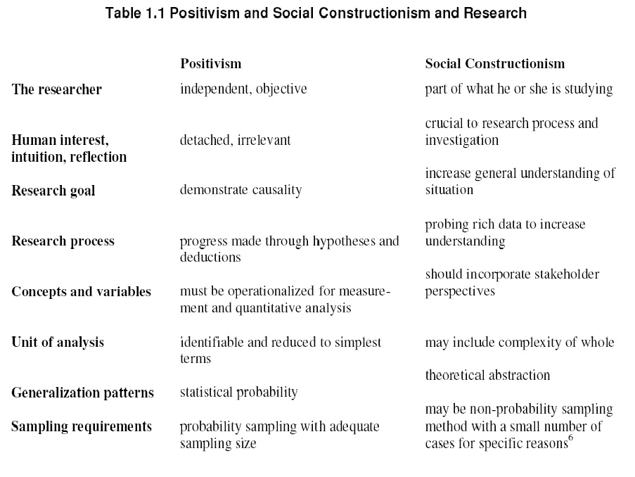

Slide 34
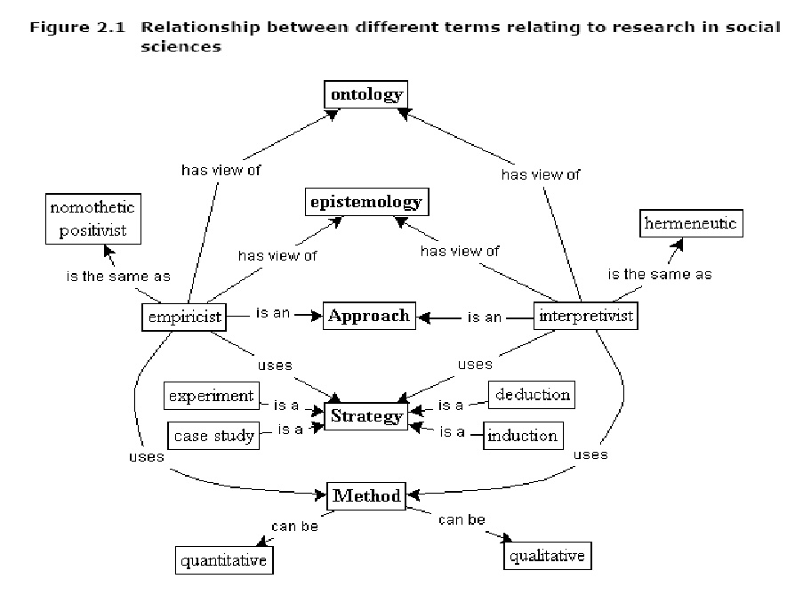

Slide 35
Sparkes, 2007
All researchers who plan to explore objectives should explain their worldview, “since it uses a methodology of the heart to some extent and at least begs for consideration”

Slide 36
Mixed Methods
Research Methods
Researchers Worldview about nature of knowledge - epistemology
Assumptions of Approach
Qualitative Research Paradigm
Quantitative Research Paradigm
Positivism
Post Positivism
Critical Theory
Constructivism
Participatory
Pragmatism
Ontological Perceptions of reality
Multiple subjectively derived realities co-exist
Single objective world
Worldviews influence basic beliefs of
who informs,
who forms
and who benefit from the inquiry
Also influences mode or strategy or research tradition
Epistemological Theory of knowledge
Researchers interact with phenomenon (personal investment)
Researchers are independent from the variables under study (detached)
Axiological
Study of underlying values
Researchers act in a value-laden and biased fashion
Researchers act in a value-free and unbiased manner
Quantitative
Arising mainly from positivism & post positivism
Qualitative
Mainly coming from critical theory, constructivism & participatory paradigms
Mixed Methods
From the pragmatic paradigm
Rhetorical
Use of language
Use personalized, informal and context-based language
Use impersonal, formal and rule-based text
Methodological
Researchers use induction, multi-process interventions, context-specific methods
Researchers use deduction, cause-and-effect relationship and context-free methods
Approaches and techniques
And way in which questions are formulated, data is collected and analyzed
MIXED METHODS
Booyse, 2012
Notes:
Exploratory - Suggests directions and feasibility of future research, Usually focused on the “what,” not the “why”. Frequently uses qualitative techniques to develop initial data and ideas
Descriptive - Presents a picture with specific details of the situation or behavior, Requires a focused research question/topic, Often blurs with/follows exploratory research
Focuses on “how” and “who” questions, Is necessary for good explanatory research
Explanatory -Focuses on “why”, or the reason a situation or behavior occurs, Builds on exploratory and descriptive research, and other explanatory research
Uses theory, Much of the research published in journals is explanatory

Slide 37
Research
Mouton (1996:28) simply states that: the predominant purpose of all research is to arrive at results that are as close to the truth as possible.

Slide 38
Research Design
Cooper and Schindler (2011: 139, 727) concur that a research design is “an activity- and time-based plan; a blueprint for fulfilling research objectives and answering question”.
A research design can be likened to a house plan, which shows on paper what the final house is going to look like and guides a builder on how the house should be built (Mouton: 2001).

Slide 39
Lynham (2002)
Two common theory building strategies
Research-to theory strategy
Theory-to-research strategy
Inductive-deductive nature
Well applied to behavioural and human sciences
Post modernistic
“data does not create theory or models, humans do” Mintzberg in Saha & Corley (2006)

Slide 40
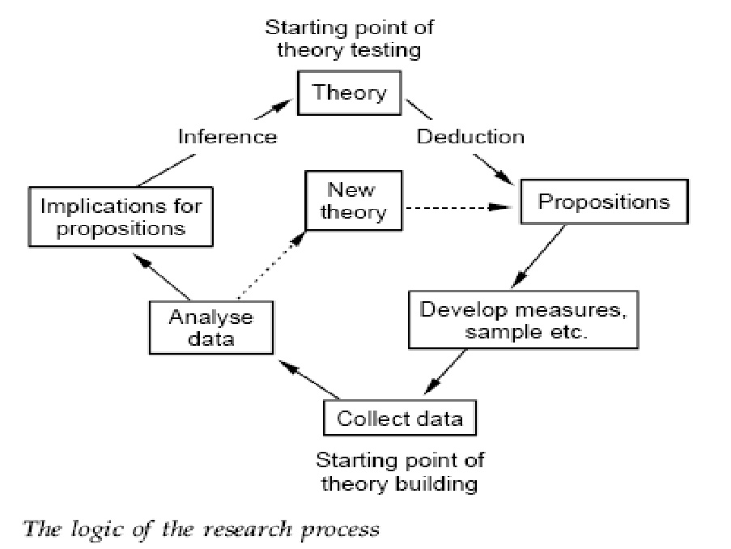

Slide 41
Lynham (2002)
5 phases:
Conceptual development
Operationalisation
Application
Confirmation or disconfirmation
Continues refinement and development

Slide 42
Lynham (2002)
Phase 1:
Conceptual development
Cresswell (2008)
Use literature to identify themes and patterns in definitions and use of the concept to obtain clarification in previous studies
Develop an informed conceptual framework that povides an initial understanding and explanation of the natiure and dynamics of the phenomonon

Slide 43
Lynham (2002)
Phase 2:
Operationalisation
Explicit connection between the conceptualisation phace and practice
Link theoretial ideas, conepts, models to practice
Form theoretical frameowk of the model to be build
Include design and explanation of the model that could be applied in practice
You continue until no substantively different information could be found and saturation thus experienced (Shah and Corley, 2006)

Slide 44
Lynham (2002)
Phase 3:
Confirmation or disconfirmation
This involves the planning, design, implementation and evaluation of a research agenda
Literature search and review focused on the envisioned model to be devloped t, to clarify and explain the model and to ensure that no reference suggest porobalbe falsification of theory behind model (Popper in Lynham, 2002)

Slide 45
Lynham (2002)
Positivism
If you believe that theories of phenomenon under studie do exist out there between the lines of scientist that use the concept but need to be fiound, also on more post modernistic lines, to be explained
Greggor and Jones (20007)
Any researcher will find more or less the same result, independet of their worldiew
Dubin (1978) explains that by constructing theory this way, the aim is to make sense of what is observed in the use of the concept, by ordering the relationships among elements in the focus of the study

Slide 46
Lynham (2002)
Phase 4:
Application and emperical testing
Phase 5: continous refinement
Continoues leterature review progress

Slide 47
Triangulation
Easterby-Smith, Thorpe and Lowe (1991) as cited by Da Vinci (2009:14), define the following four types of triangulation:
Data Triangulation: Data is collected at different times and source and combined, or compared to increase confidence;
Investigator Triangulation: data is gathered by different investigators, independently and compared/combined to increase confidence;
Methodological Triangulation: Using both qualitative and quantitative methods to increase confidence, and
Theories Triangulation: using two different theories to explain the same problem.

Slide 48
Questions
Dr Rica Viljoen
Mandala Consulting
0824495846
rica@mandalaconsulting.co.za

